Slide 1
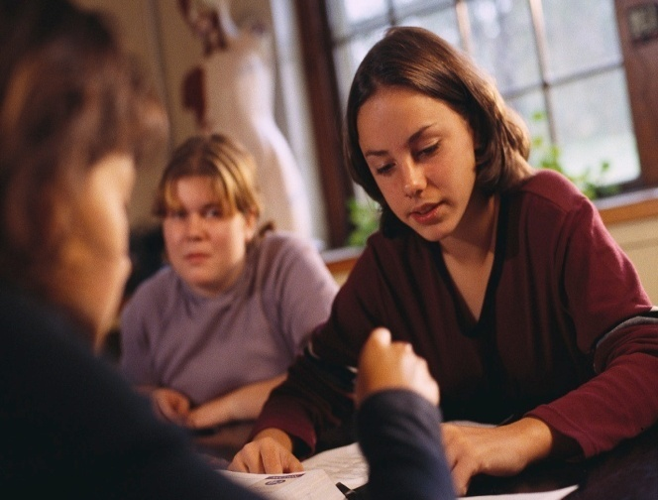
UNIVERSITY OF PANAMA
VICEPRESIDENCY OF RESEARCH AND
GRADUATE STUDIES
COLLEGE OF HUMANITIES
ENGLISH DEPARTMENT
BASIC ENGLISH GRAMMAR
BY
MARISOL ORTEGA DE ALVAREZ

Slide 2
introduction
English grammar is a set of rules that describe the structure of the language. We use grammar all the time when we speak or write. The study of grammar is necessary for the correct use of the English language; especially, the written language since the written language is more formal than the spoken language. The spoken language or literary dialogue puts up with many grammar mistakes that are part of a person, or cultural group, or part of the written language of the author of an article or literary work. Grammar is the structural foundation of our ability to express ourselves. The more we are aware of how it works, the more we can monitor the meaning and effectiveness of the way we and others use language. It can help foster precision, detect ambiguity, and exploit the richness of expression available in English. And it can help everyone--not only teachers of English, but teachers of anything, for all teaching is ultimately a matter of getting to grips with meaning. (David Crystal, "In Word and Deed," TES Teacher, April 30, 2004)

Slide 3

OBJECTIVES
To analyze the basic structures of the English language.
To use the basic structures of the English language correctly.

Slide 4

COURSE CONTENTS
Simple Present Tense (The use of do/does)
Positive statement structure
Subject + verb:
She likes apples.
Negative statement structure:
Subject+ auxiliary verb (do/does) +not + main verb:
She does not like apples.

Slide 5
 | Subject | Auxiliary verb |  | Main verb
Affirmative statements | I, you, we, they |  |  | like | apples.
 | He, she, it |  |  | likes | apples.
Negative statements | I, you, we, they | do | not | like | apples.
 | He, she, it | does | not | like | apples.
Yes/no questions |  | Do | I, you, we, they | like | apples?
 |  | Does | he, she, it | like | apples?

Slide 6
Note: When the auxiliary does is used in the sentence, the verb goes back to its base form.
We use the simple present tense when:
the action is general.
the action happens all the time, or habitually.
the statement is always true.
Examples: I live in Panama (the action happens all
the time or habitually).
Peter works for that company (the action is general).
The moon shines at night (the statement is always true).

Slide 7
SPELLING
Verbs ending in o or a sibilant (ch, sh, s, x) add
es instead of s.
example: go - She goes.
wash - He washes.
A final y after a consonant becomes ie before s.
example: worry - He worries.
A final y after a vowel (a, e, i, o, u) is not modified.
example: play - He plays.

Slide 8
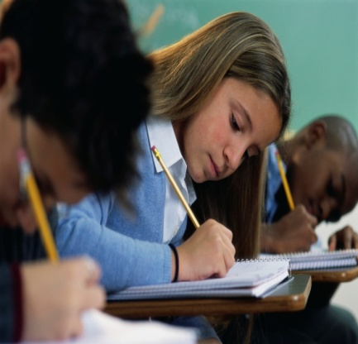
WH-questions with The simple present tense
The "wh-questions" are a group of questions that begin with a wh-word: what, when, which, why who, where, whom, whose and also questions that begin with "how" that belong to this group because the word behaves the same way. These questions ask specific information.

Slide 9
Wh- question Structure:
Wh- question word + Aux do/does + subject + verb (+ complement) + ?
Use does only with the third person singular
(he, she, it in negative statements and
questions).

Slide 10

Wh- question word | Aux do/does | subject | verb | (complement) + ?
Where | do | you | work | in the morning ?
Why | does | she | come | every day?
Which phone | does | he | like | ?
Who | do | they | play | with?

Slide 11
SIMPLE PRESENT TENSE WITH THE VERB TO BE
Notice that there is no auxiliary (do/does):
 | subject | main verb
Affirmative statements | I | am |  | Panamanian.
 | You, we, they | are |  | Panamanian.
 | He, she, it | is |  | Panamanian.
Negative statements | I | am | not | Panamanian.
 | You, we, they | are | not | Panamanian.
 | He, she, it | is | not | Panamanian.
Yes/no questions | Am | I |  | Panamanian?
 | Are | you, we, they |  | Panamanian?
 | Is | he, she, it |  | Panamanian?

Slide 12
The Present Continuous Tense
Subject + auxiliary (verb to be) + verb with –ing (+ compliment)
The man is using his tools.
 | subject | auxiliary verb |  | main verb | compliment
Affirmative statements | I | am |  | reading | a book.
 | You | are |  | reading | the lesson.
Negative statements | She | is | not | taking | that course.
 | We | are | not | playing | tennis.
Yes/no questions | Is | he |  | watching | TV?
 | Are | we |  | staying | ?
 | Are | they |  | eating | apples?

Slide 13
We use the present continuous tense to talk about activities happening now.
Examples:
The boy is playing with his toys.
Why are you crying? I am crying because I am sad.
Who are you writing to?
The present continuous tense is also used to talk about activities that are not
necessarily happening at this very moment, but around now.
Examples:
Peter is studying for his final exam.
Laura is not studying hard. She is always talking on the phone.
I am reading a very interesting book.
We also use the present continuous tense to talk about activities happening in the
near future, especially for planned future events.
Examples:
My mother is coming for lunch tomorrow.
We are not going to the country side next week.
Are you doing anything this afternoon?

Slide 14
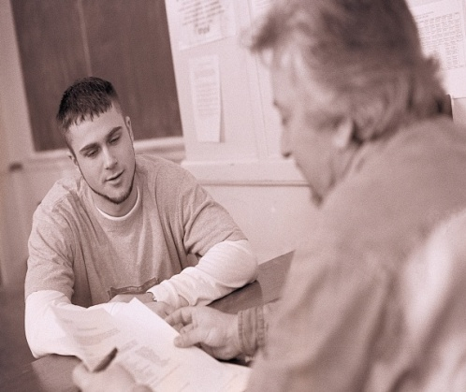
SPELLING
A single, silent e at the end of the word is dropped before ing.
But ee at the end of the word is not changed-
example: come - coming
I am coming home. You are coming home. He is coming home.
example: agree - agreeing
The final consonant after a short, stressed vowel is doubled before ing.
example: sit - sitting
I am sitting on the sofa. You are sitting on the sofa. He is sitting on the sofa.
An ie at the end of a word becomes y before ing.
example: lie - lying
I am lying in bed. You are lying in bed. He is lying in bed.
Have:
Use have with the personal pronouns I, you, we and they (or with the plural form of nouns).
Use has with the personal pronouns he, she, it (or with the singular form of nouns).

Slide 15
 | Affirmative | Negative | Question
I/you/we/they | I have. | I do not have. | Do I have?
he/she/it | He has. | He does not have. | Does he have?
THE SIMPLE PAST TENSE
Structure:
I, you, he, she, it, we, you, they + VERB (PAST FORM) + Complement
Positive | Negative | Yes/no question | Wh-question
He stayed in Panama. | He didn’t stay in Panama. | Did he stay in Panama? | Where did he stay?

Slide 16
Note: When the auxiliary did is used in the sentence, the verb goes back to its base form.
The past tense of a regular verb is formed by adding “ed” to the verb. Examples:
Present | Past
work | worked
start | started
end | ended
SPELLING
A final consonant after a short, stressed vowel is doubled. | admit – admitted
A final y after a consonant becomes i. | study – studied
A final y after a vowel stays the same. | play - played

Slide 17
We use the Simple Past to express the idea that an action started and finished at a specific time in the past.
Examples:
I saw a movie yesterday.
He came with his brother.
They studied for two hours.
The Simple Past can also be used to describe past facts or generalizations which are no longer true.
Examples:
I didn’t like apples before.
They lived in England two years ago.
He had two houses, but he sold them.

Slide 18
Assignment
Order the following sentences using the past tense.
It a lot rain
___________________________________
My help me mother
________________________________
They street cross
___________________________________
yesterday they come
_____________________________________
stay Bill home
______________________________________
Change the following sentences to questions beginning with the given question word.
The lesson begins at 7 o´clock. What time ________________?
They get home at 9 o´clock every night. What time ______________?
She speaks German very well. What ______________________?
Those books cost four dollars. How much ___________________?
They travel by plane. How _______________________?

Slide 19
They meet at the restaurant every morning. Where ___________ ?
They live in Panama. Where___________________?
He gets up at five every morning. When____________________?
She teaches us spelling. What _______________?
They eat apples every day. _________________?
Write down the -ing form of the following words. Mind the exceptions in
spelling.
Have __________________
Sit ____________________
Run ___________________
Stop ___________________
Lie _____________________
End ____________________
Play ___________________
Begin __________________
Agree __________________
Cry ____________________

Slide 20
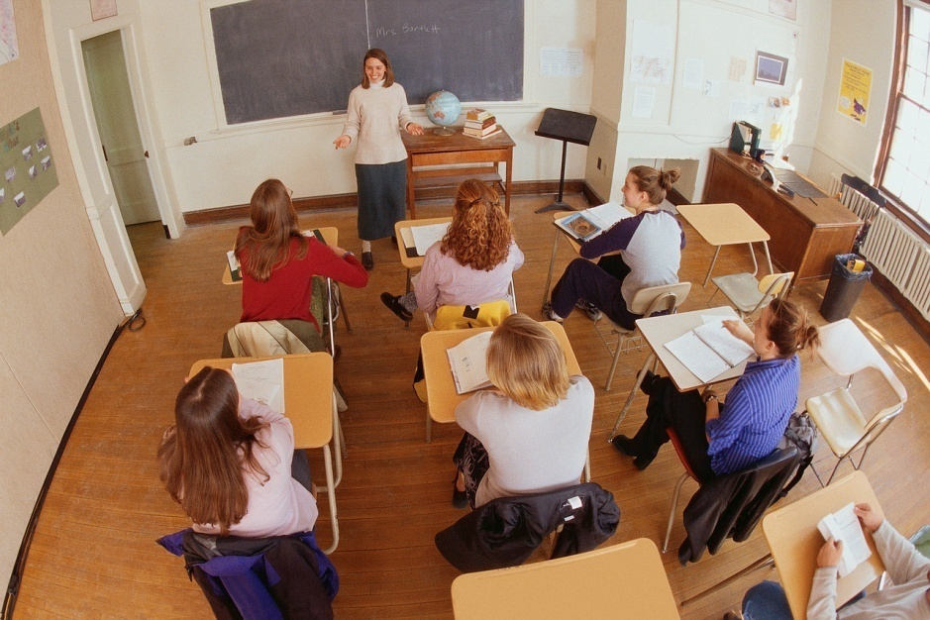
Re-order the sentences correctly and identify the tense of the sentences.
I twenty five am year old
_________________________________.
Bill brother’s name is her
___________________________________.
Twenty-two am years I old
___________________________________
my is this book.
___________________________________
my is husband’s name Andres
_____________________________________
her Gloria is test for studying final.
______________________________________
time having a are good they
______________________________________
seven Peter languages speaks
_______________________________________
do me want you come to When?
_________________________________________
not taking I course that am
_______________________________________

Slide 21
Past Continuous Tense
Subject + auxiliary (was/were) + verb with –ing (+ compliment)
 | subject | auxiliary verb |  | main verb | compliment
Affirmative statements | I | was |  | reading | a book.
 | You | were |  | reading | the lesson.
Negative statements | She | was | not | taking | that course.
 | We | were | not | playing | tennis.
Yes/no questions | was | he |  | watching | TV?
 | were | we |  | staying | ?
 | were | they |  | eating | apples?

Slide 22
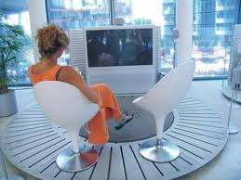
We use the past continuous to describe an action in progress at a particular time in the past.
Examples:
They were doing homework when the bell rang.
They were not doing homework when the bell rang.
Were they doing homework when he the bell rang?
We use the past continuous to indicate that an action in the past was interrupted. The interruption is usually a shorter action in the Simple Past.
Examples:
While I was watching TV, I got a phone call.
He was waiting for me when I arrived.

Slide 23
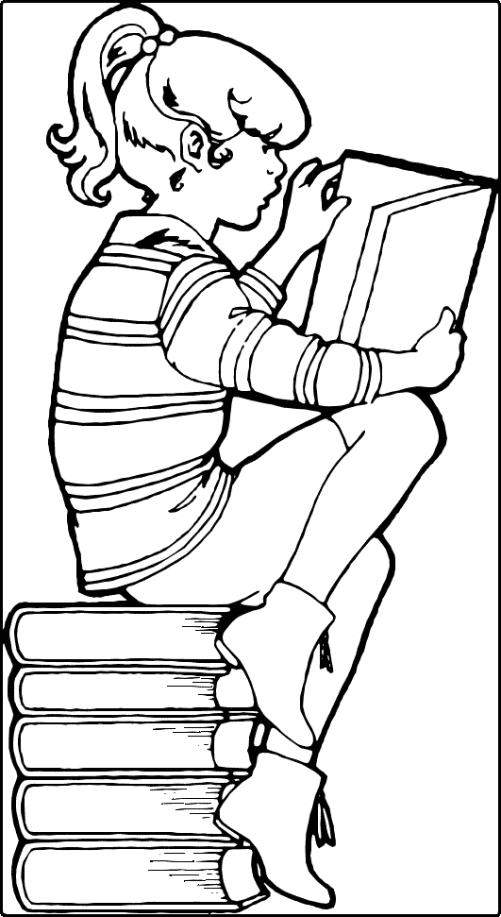
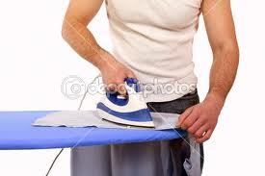
When the actions are parallel, we use the past continuous with the two actions.
Examples:
I was reading while he was ironing.
He was not paying attention while
his mother was talking.

Slide 24
Assignment
Use the correct form of the past continuous and the verb in brackets
1. Yesterday at four I ______________ (work).
2. He _____________________(practice) the guitar.
3. While Andres ______________ (clean) his room, his mother ___________ (cook) dinner.
4. What ________________ (you/do) when you broke your leg?
5. The children _______________(watch) television while Peter _______________ (read).

Slide 25
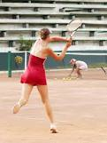
Used to
We use 'used to' when we want to emphasize that something happened regularly in the past but no longer happens.
Structure:
The structure used to + infinitive only exists in the past.
Examples:
I used to play tennis when I was young.
She used to teach physics at the University of Panama.

Slide 26
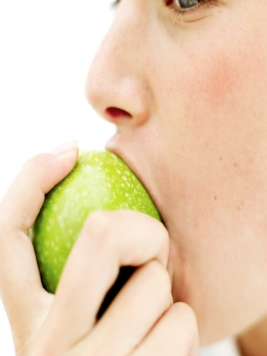
We also use it when we want to emphasize that something was true but no longer is.
Examples:
I didn’t use to like green apples, but now I do.
He used to come very often, but now he doesn’t
Yes /no question structure:
Yes/no question: Did + subject + use to+ verb+?
Example:
Did you use to like green apples when you were a child?
Wh –question structure:
Wh-question word + aux did + subject + use to + verb +?
Example:
What did you use to eat when you were a child?
Notice that use goes back to its base form because the auxiliary
did is being used in the sentence.

Slide 27
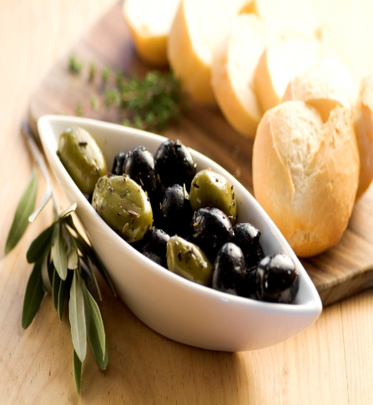
Be used to
Structure:
Be used to + -ing form or a noun or a pronoun (The tense
is shown on be).
We use be used to doing or a noun or a pronoun to talk
about something that we are accustomed to.
Examples:
They are used to eating olives.
He is not used to exercising every day.
Be used to + noun
Example:
When I lived in England I was used to the cold weather, but now
I am used to the Panamanian hot weather.

Slide 28
Assignment
When I was a child, I used to dream of my graduation day.
Complete the sentences with the appropriate form of
used to and the verb in brackets.
1. It is difficult for Bill to drive in Panama. He ____________________(drive) on such narrow streets.
2. Gloria didn’t ___________________ (have) a blackberry, but now she does.
3. Computers _________________(be) very expensive. Now the prices are more reasonable.
4. People from Jamaica __________________ (eat) spicy food. They find our food tasteless.
5. When Carlos was young, he ________________ (ride) a bicycle to school.

